Slide 1
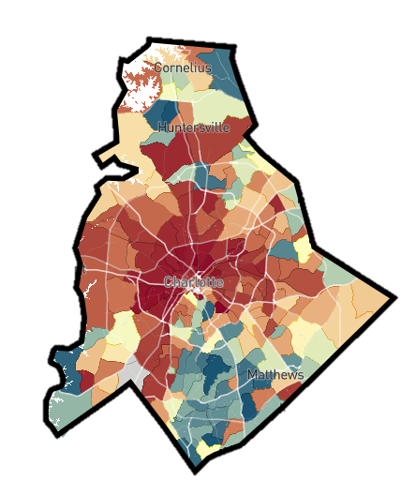



Three Policy Approaches to Increasing Upward Mobility
Reducing
Segregation
Place-Based
Investments
Higher Education & Workforce Training
Help Low-Income
Families Move to
High-Opportunity Areas
Increase Upward Mobility in Low-Opportunity Areas
Amplify Impacts of Colleges and Training Programs on Mobility

Slide 2
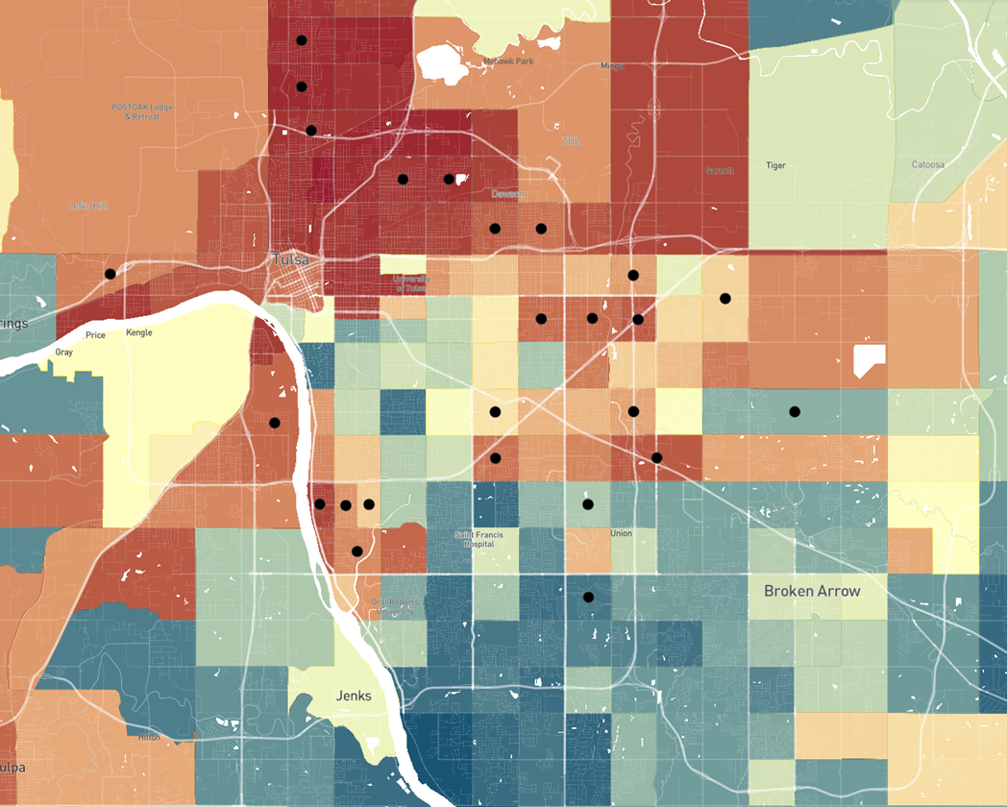

Where Housing Voucher Holders Live in Tulsa
25 most common tracts where voucher holders lived in 2015-19
<$30k
$50k
>$83k
Blue = More Upward Mobility
Red = Less Upward Mobility

Slide 3
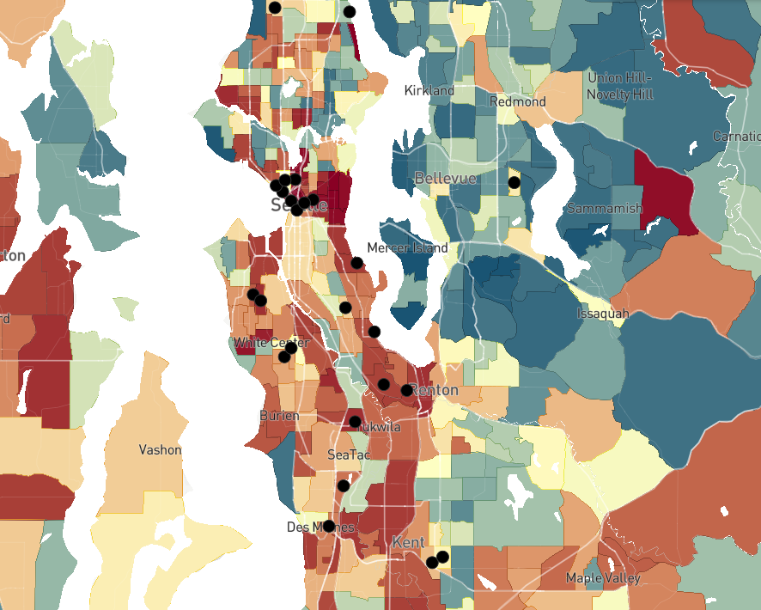
Where Housing Voucher Holders Live in Seattle
25 most common tracts where voucher holders lived in 2015-19
<$36k
$57k
>$84k
Blue = More Upward Mobility
Red = Less Upward Mobility

Slide 4





Creating Moves to Opportunity Experiment
Seattle and King County, WA
Randomized trial to test strategies to reduce barriers that voucher recipients face in moving to high-opportunity areas:
Customized counseling
Connections to landlords
Short-term financial assistance

Slide 5
Fraction of Families Who Leased Units in High-Opportunity Areas
Phase I Results
Source: Bergman, Chetty, DeLuca, Hendren, Katz, Palmer (AER 2023)

Slide 6
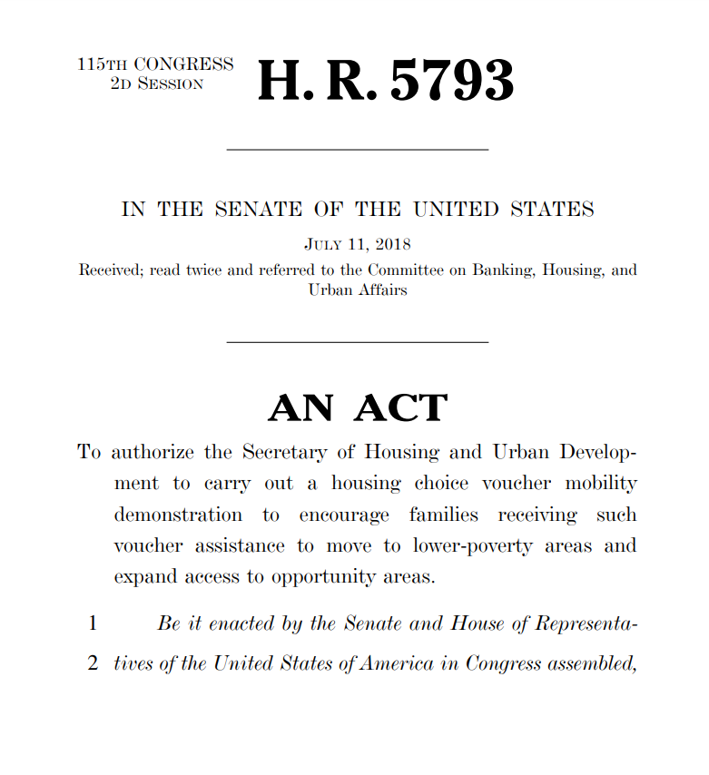
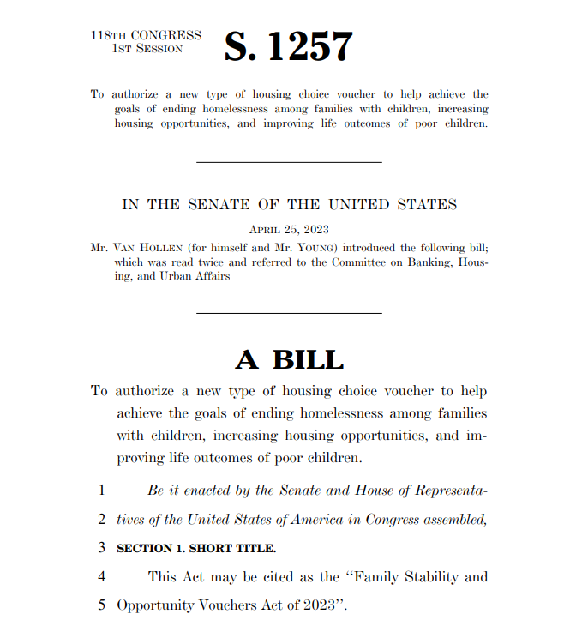
From Research to Policy
Impacts on Federal Affordable Housing Policies
2018
Housing Choice Voucher Mobility Demonstration Act
2023
Family Stability and Opportunity Vouchers Act
Social support increased moves to high-opportunity areas by 6x
Source: Congress.gov; Rapid Cycle Evaluation Report (HUD 2024)

Slide 7
Three Policy Approaches to Increasing Upward Mobility
Reducing
Segregation
Place-Based
Investments
Higher Education & Workforce Training
Help Low-Income
Families Move to
High-Opportunity Areas
Increase Upward Mobility in Low-Opportunity Areas
Amplify Impacts of Colleges and Training Programs on Mobility

Slide 8
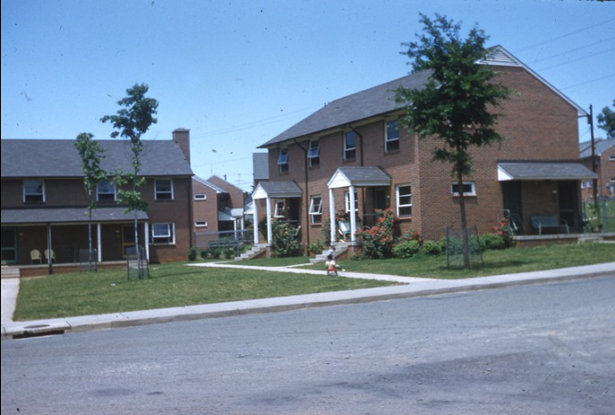
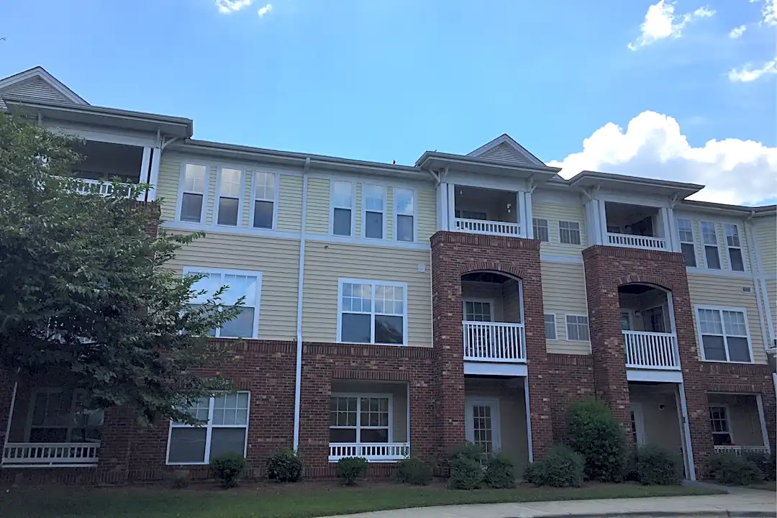
HOPE VI Neighborhood Revitalization Program
Housing Opportunities for People Everywhere: $16.7 bn spent to Revitalize 261 Public Housing Sites (1993-2010)
Before Revitalization
Happy Hill Gardens, Winston-Salem
After Revitalization
Alders Point, Winston-Salem
Source: Chetty, Diamond, Foster, Katz, Porter, Staiger, Tach 2025
Notes:
Customize to where you’re presenting if possible

Slide 9
Impact of Revitalization on Children’s Incomes in Adulthood
Children Living in Public Housing Before vs. After Award
$28k
Moved Out More Than One
Year Before HOPE VI Grant
$27k
$26k
$25k
Child’s Income in Adulthood
$24k
$23k
$22k
-10
-5
0
5
10
Year Relative to HOPE VI Grant
Source: Chetty, Diamond, Foster, Katz, Porter, Staiger, Tach (2025)

Slide 10
Impact of Revitalization on Children’s Incomes in Adulthood
Children Living in Public Housing Before vs. After Award
$28k
Moved Out More Than One
Year Before HOPE VI Grant
$27k
Moved In After HOPE VI Grant
$26k
$25k
Child’s Income in Adulthood
+$500K
in additional lifetime income
$24k
$23k
$22k
-10
-5
0
5
10
Year Relative to HOPE VI Grant
Source: Chetty, Diamond, Foster, Katz, Porter, Staiger, Tach (2025)

Slide 11
Impacts of Revitalization by Incomes in Surrounding Community
$5k
$4k
$3k
Impact of HOPE VI Revitalization
on Children’s Earnings in Adulthood
$2k
$1k
$0
Low
Middle
High
Average Income in Adulthood for Similar Children Living Within One Mile
Source: Chetty, Diamond, Foster, Katz, Porter, Staiger, Tach (2026)

Slide 12


Communities in Schools
Comprehensive student support program that provides services to help students overcome barriers:
Academic tutoring
Mental health counseling
Basic needs assistance
Family engagement
+$100K
in additional lifetime income
Source: Goldman, Gracie, and Porter (2025)
Notes:
Option 2

